Slide 1

Machine Learning · Mini Project
MACHINE LEARNING · MINI PROJECT
Predicting Coral Reef Regimes from Human and Natural Influences
Replicating a Stanford CS229 baseline on the Hawaii Regimes dataset and extending it with K-Nearest Neighbors
PART 1 · BASELINES
PART 2 · EXTENSION
PART 3 · COMPARISON
EDA and replication of Logistic Regression and Random Forest
KNN with 5-fold cross-validation and hyperparameter tuning
Micro-F1 and class-wise errors against the reference models
HARIOM N KINI PES2UG24CS672
AMIT PES2UG24CS624
1

Slide 2
Machine Learning · Mini Project
Problem statement and objectives
Classify Hawaiian reef locations into one of four ecological regimes
“Predict which of four coral reef regimes (1, 2, 3 or 5) a reef location in Hawaii falls into, using 25 human and natural environmental factors.”
GIVEN
FIND
THE DIFFICULTY
620 reef locations, each with 25 numeric predictors: fishing, pollution, temperature, waves, depth.
The regime of each location, so reef health can be read from its surroundings.
Human and natural drivers overlap, the data is noisy, and only 496 rows are available for training.
PROJECT OBJECTIVES
1
Replicate the paper’s Logistic Regression and Random Forest baselines
2
Build a model the paper did not report: K-Nearest Neighbors
3
Tune KNN with 5-fold cross-validation on micro-F1
4
Compare fairly: same split, same 25 features, same metric
2

Slide 3
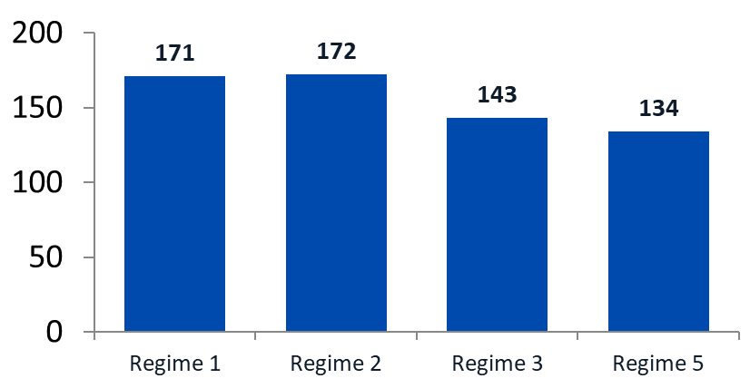
Machine Learning · Mini Project
Dataset and preprocessing
Hawaii Regimes dataset used by the reference paper
620
496 / 124
25
4
spatial observations
train / test (80/20)
features: 20 raw + 5 engineered
target regimes: 1, 2, 3, 5
CLASS BALANCE · 620 LOCATIONS
PREPROCESSING
Missing values: Complexity (113) and Depth (12), imputed in the paper’s prepared files
Features: 5 engineered interaction terms added to 20 raw predictors
Scaling: StandardScaler inside the Pipeline, fitted on training folds only
Split: the paper’s fixed 80/20 split reused (train + validation = 496)
3

Slide 4
Machine Learning · Mini Project
Experimental methodology
From raw predictors to a held-out test score
1 Load
2 Split
3 Preprocess
4 Train
5 Tune
6 Evaluate
Prepared train, validation and test files
496 train rows, 124 test rows
25 features, then StandardScaler
Fit Logistic Regression, Random Forest, KNN
5-fold CV grid search for KNN
Test set used once, at the end
EVALUATION METRIC
MODEL SELECTION
FAIR COMPARISON
Micro-averaged F1 pools every prediction. It suits four classes that are only mildly imbalanced (22% to 28% each).
Choose settings on 5-fold CV over the 496 training rows. The 124 test rows are scored once.
Same data, split, 25 features and metric as the Stanford CS229 reference models.
Leakage control: the scaler sits inside the scikit-learn Pipeline, so each CV fold is scaled using only its own training rows.
4

Slide 5
Machine Learning · Mini Project
Models evaluated
Two replicated baselines and one new model
REPLICATED BASELINE
REPLICATED · PAPER’S BEST
OUR EXTENSION
Logistic Regression
Random Forest
K-Nearest Neighbors
StandardScaler, then LogisticRegression (max_iter = 1000). The linear model from the paper.
Default scikit-learn forest (random_state = 42). Handles non-linear thresholds well.
Distance-based and not in the reference results. Pipeline: StandardScaler, then KNN.
KNN SEARCH SPACE
WHY KNN?
Neighbors (k): 3, 5, 7, 9, 11, 15, 21, 31
Weights: uniform or distance
Metric: Euclidean or Manhattan
32 configurations x 5 folds = 160 fits
A simple, interpretable contrast to the paper’s models
Tests whether distance in scaled feature space separates regimes
Paper’s SVM and Gradient Boosted Tree are reported only
5

Slide 6
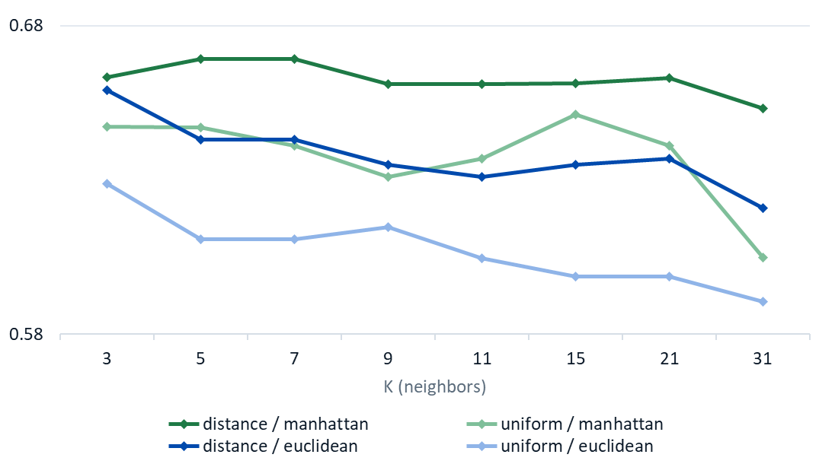
Machine Learning · Mini Project
KNN hyperparameter tuning
5-fold cross-validated micro-F1 across 32 configurations
CV MICRO-F1 vs NUMBER OF NEIGHBORS (K)
BEST CONFIGURATION
k = 7 · Manhattan · distance
CV micro-F1 = 0.669
WHAT THE SEARCH SHOWED
Manhattan beat Euclidean at almost every K
Distance weighting added about 3 points
Top 8 configurations sit within 1 point (0.659 to 0.669)
Training F1 is 1.00 with distance weights, so CV is the honest guide
6

Slide 7
Machine Learning · Mini Project
Reference paper vs our results
Micro-F1 on the same 25-feature, 496 / 124 split
Model | Paper (validation) | Ours · 5-fold CV | Ours · test | Status
Logistic Regression | 0.60 | 0.619 | 0.581 | Replicated
Random Forest | 0.70 | 0.675 | 0.726 | Replicated
KNN (our extension) | Not reported | 0.669 | 0.653 | New model
SVM · radial kernel | 0.65 | – | – | Paper only
SVM · polynomial kernel | 0.61 | – | – | Paper only
Gradient Boosted Tree | 0.69 | – | – | Paper only
Takeaway: our replication lands within about 3 points of the paper, and the paper reports a 0.70 test micro-F1 for its final Random Forest (ours: 0.726). Paper figures are validation scores from the CS229 report.
7

Slide 8
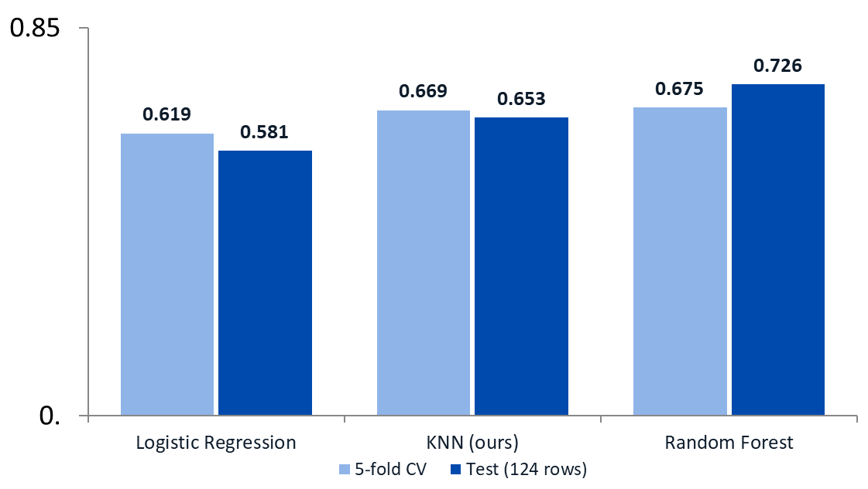
Machine Learning · Mini Project
Test results snapshot
KNN beats the linear baseline but not Random Forest
MICRO-F1 · CROSS-VALIDATION vs HELD-OUT TEST
72.6%
Random Forest test micro-F1 · best
65.3%
KNN test micro-F1 · our extension
58.1%
Logistic Regression test micro-F1
KNN sits midway: 9 more test locations right than Logistic Regression, 9 fewer than Random Forest.
8

Slide 9
Machine Learning · Mini Project
Where KNN makes mistakes
Class-wise report and confusion matrix on the 124 test locations
KNN CLASSIFICATION REPORT
CONFUSION MATRIX · ACTUAL (ROWS) vs PREDICTED
Regime | Precision | Recall | F1 | Support
1 | 0.853 | 0.659 | 0.744 | 44
2 | 0.659 | 0.730 | 0.692 | 37
3 | 0.516 | 0.640 | 0.571 | 25
5 | 0.500 | 0.500 | 0.500 | 18
Macro avg | 0.632 | 0.632 | 0.627 | 124
Actual \ Pred | 1 | 2 | 3 | 5
1 | 29 | 7 | 6 | 2
2 | 3 | 27 | 4 | 3
3 | 1 | 4 | 16 | 4
5 | 1 | 3 | 5 | 9
Regime 1: precision 0.85 but recall 0.66; 15 of 44 were sent to other regimes.
Regimes 3 and 5: confuse each other (4 + 5 errors), the closest pair.
Regime 5: hardest class, F1 0.50; only 9 of 18 found.
9

Slide 10
Machine Learning · Mini Project
Conclusion, limitations and next steps
What we learned from extending the baseline
WHAT WE DID
WHAT WE OBSERVED
Replicated Logistic Regression and Random Forest from the paper
Tuned KNN over 32 settings with 5-fold CV
Compared all three on one split, one feature set, one metric
KNN reached 65.3% test, above Logistic Regression (58.1%)
Random Forest stayed best at 72.6%
Trees cope better with messy, threshold-like environmental rules
LIMITATIONS
NEXT STEPS
Only 124 test rows: one location moves the score 0.8 points
Test mix differs: Regime 1 is 35% vs 26% in training
KNN with distance weights fits training data perfectly
Replicate the paper’s SVM and Gradient Boosted Tree
Use repeated CV for steadier estimates
Try feature selection to cut noise for KNN
10

Slide 11
Machine Learning · Mini Project
Thank you
HARIOM N KINI PES2UG24CS672
Amit PES2UG24CS624
Code and results: github.com/amitsonale/Hawaii-Coral-Reef-ML
PES University, Bengaluru
11

